Slide 1
UE18CS390B – Capstone Project Phase – 2
Project Progress Review #1
Project Title : Forecasting future trending topics using
text data
Project ID : PWS
Project Guide : Dinesh Singh
Project Team : Kavishankar K S PES1201802001
Mohammed Zeeshan PES1201801814
Rohan M PES1201801798

Slide 2
Outline
Abstract and Scope of the Project
Capstone Project Phase – 1
Summary of work
Inferences drawn from Literature Survey
Expected Deliverables
Gantt chart

Slide 3
Abstract and Scope
Forecasting is one of the most important and frequently addressed problem in analytics.
Inaccurate forecasting can have significant impact on both top line and bottom line of an organization. Thus, it becomes necessary to forecast the demand for a product and service as accurately as possible.
Rather than solving a business problem, here we are proposed a approach of solving general forecasting problems
in many fields.

Slide 4
Scope
Amazon.com sells more than 350 million products through its E-commerce portal.(Ali, 2017) so predicting trends help in maintaining stocks.
Helps in predicting trend in stock market.
Products can be customised for ongoing trend.
Business model can be more concentrated on upcoming trends.
Content creators can create content way ahead.
Major decisions are made based or keeping in mind of upcoming trends.
Outbreak of diseases can be forecasting helps related sector to be organised to fight against disease.

Slide 5
Abstract and Scope
HOW
IT STARTED
1)Collecting all trending topics from social media platforms
2)Analysing topics having high frequency.
3)Based on frequence applying apriori algorithm
4)Forecasting item having higher frequency as trending.
IT’S GOING
1)Input is given as keyword or list of keywords
2)keyword related articles are fetched from the internet.
3)From article we are extracting related and associated keywords.
4)Extracting search data of individual keywords.
5)Forecasting individual keywords data using ARIMA model.
6)Training everything using NN.

Slide 6
cases
FORECASTING
INDIVIDUALLY
USING
ARIMA
Gathering search data
of individual related topics
symptom
search articles and news related to corona and finding top associated words using TF-IDF
Corona
lockdown
tests
Vaccine
GRAN NEURAL NETWORK

Slide 7


Outline
Why not data from twitter:
The trending tweets are mainly based on community not on population
Trend sometimes given weightage based on popularity
Entire population not concerned about the trend
The information in hashtag is seem to inadequate in our case
ex: #fridaymorning #mybreakfast #ssrip, #asksrk
Meagor amount of past information about trending tweets.
Its mainly concerned about political, and entertainment and regional issues.
Why not from youtube trends
It contains trends of the video and past trends are very difficult to access
Trend of video does not last more weeks as we observed.
The major trend in this is irregular trend.

Slide 8
Summary of Work Done in Capstone Project Phase - 1
Summary of Phase – 1.
In phase 1 we have worked on finding out the api’s and techniques for gather trends data and completed part of the research paper and created organised model by summing up all the research paper survey.
We collected trending topics from youtube, twitter and
Google trends.
As suggested by panel we have worked deeply to get some strong insights about topic.

Slide 9
Expected Deliverables
List of tasks/Modules to be elaborated in discussion with the guide.
Deciding Data Source.
Why not youtube data
It contains trends of the video and past trends are very difficult to access Trend of video does not last more weeks as we observed
The major trend in this is irregular trend.

Slide 10
Data Collection
->Google trends data of number of se using pytrends .
->News articles
->web pages from google search results collected using web scraping.
Data Preparation
->Key words are extracted based on TF-IDF and correlation score.
->Extracted articles are converted into bag of words(bow).
->From BOW most frequent topics are extracted.
.Data Input
->KEYWORDS

Slide 11
Data Pre-processing
-> Articles to transaction transformation.
->Topic discovery from transaction: association rule mining.
->Temporal topic feature characterization:validating frequency.
->Stop words need to be removed from every news articles and web page collected.
->Topic Correlation calculation

Slide 12
Expected Deliverables
3. Tabulate the individual contribution of the team
members with the following,
Tasks/Modules assigned
Development (no. of lines of code & time spent)
4. Technologies used
->For Data collection
Google trend api for data collection
Beautifulsoup for web scraping
->Front End
Apache server for hosting website
Flask web application.

Slide 13
->libraries used
Keras
numpy
pandas
5. Testing for the module that is completed.
Data collected from google trends api.
Exploratory data analysis on retrieved data.

Slide 14
An article related to given keyword is generated from wikipedia
Our work till now
Search queries dataset is generated from the google
within a instance as
specified duration
on monthly basis.
Line chart is plotted for the key word.
Using ARIMA Model forecasting is done for the same keyword
Given a keyword
or multiple keywords
Related keywords are generated from google trends..
Keywords are reprocessed and top five keywords data is extracted and plotting of variation graph.
An article related to given keyword is generated from wikipedia.

Slide 15
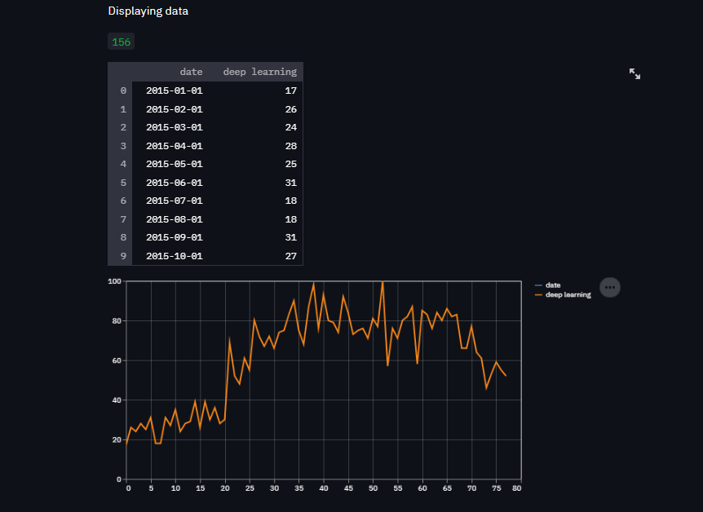
6. Demonstration and Result of modules completed.
Graph comparison from google trends api data

Slide 16
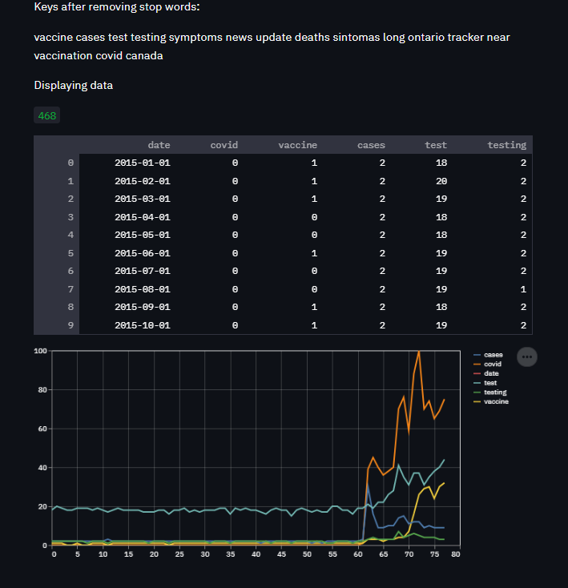

Slide 17
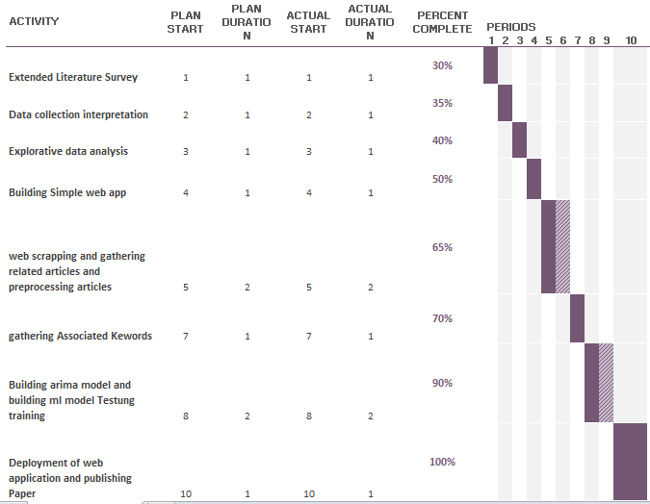
7. Tabulate the timeline for all the tasks/modules.
gantt chart

Slide 18
References
References:
Jose L. Hurtado*† , Ankur Agarwal† and Xingquan Zhu†,
”Topic discovery and future trend forecasting for texts”
2. Roselina Sallehuddin, Siti Mariyam Hj. Shamsuddin, Siti Zaiton Mohd. Hashim,,Ajith Abrahamy, “Forecasting Time Series Data Using Hybrid GREY Neural Network And ARIMA Model”.

Slide 19
References
3. “YouTube View Prediction with Machine Learning”
Int. J. Business Information Systems, Vol. 13, No. 3, 2013 359
4. Conrad Tucker1 and Harrison M. Kim1 (1)
“PREDICTING EMERGING PRODUCT DESIGN TREND BY MINING PUBLICLY AVAILABLE CUSTOMER REVIEW DATA”.- University of Illinois at Urbana-Champaign, USA.

Slide 20
Thank You

